Slide 1
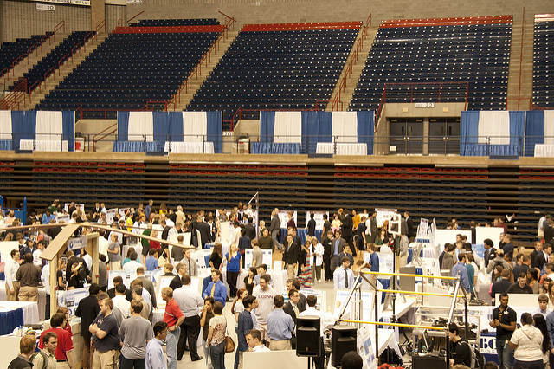
UConn Senior Design
Overview
Year-long design project
Corporate Sponsor gives “donation” of ~$10,000
Teams of students work to solve industry problems
Projects are displayed at UConn School of Engineering “Demonstration Day”

